Slide 1
Nikki Gamble

Slide 3
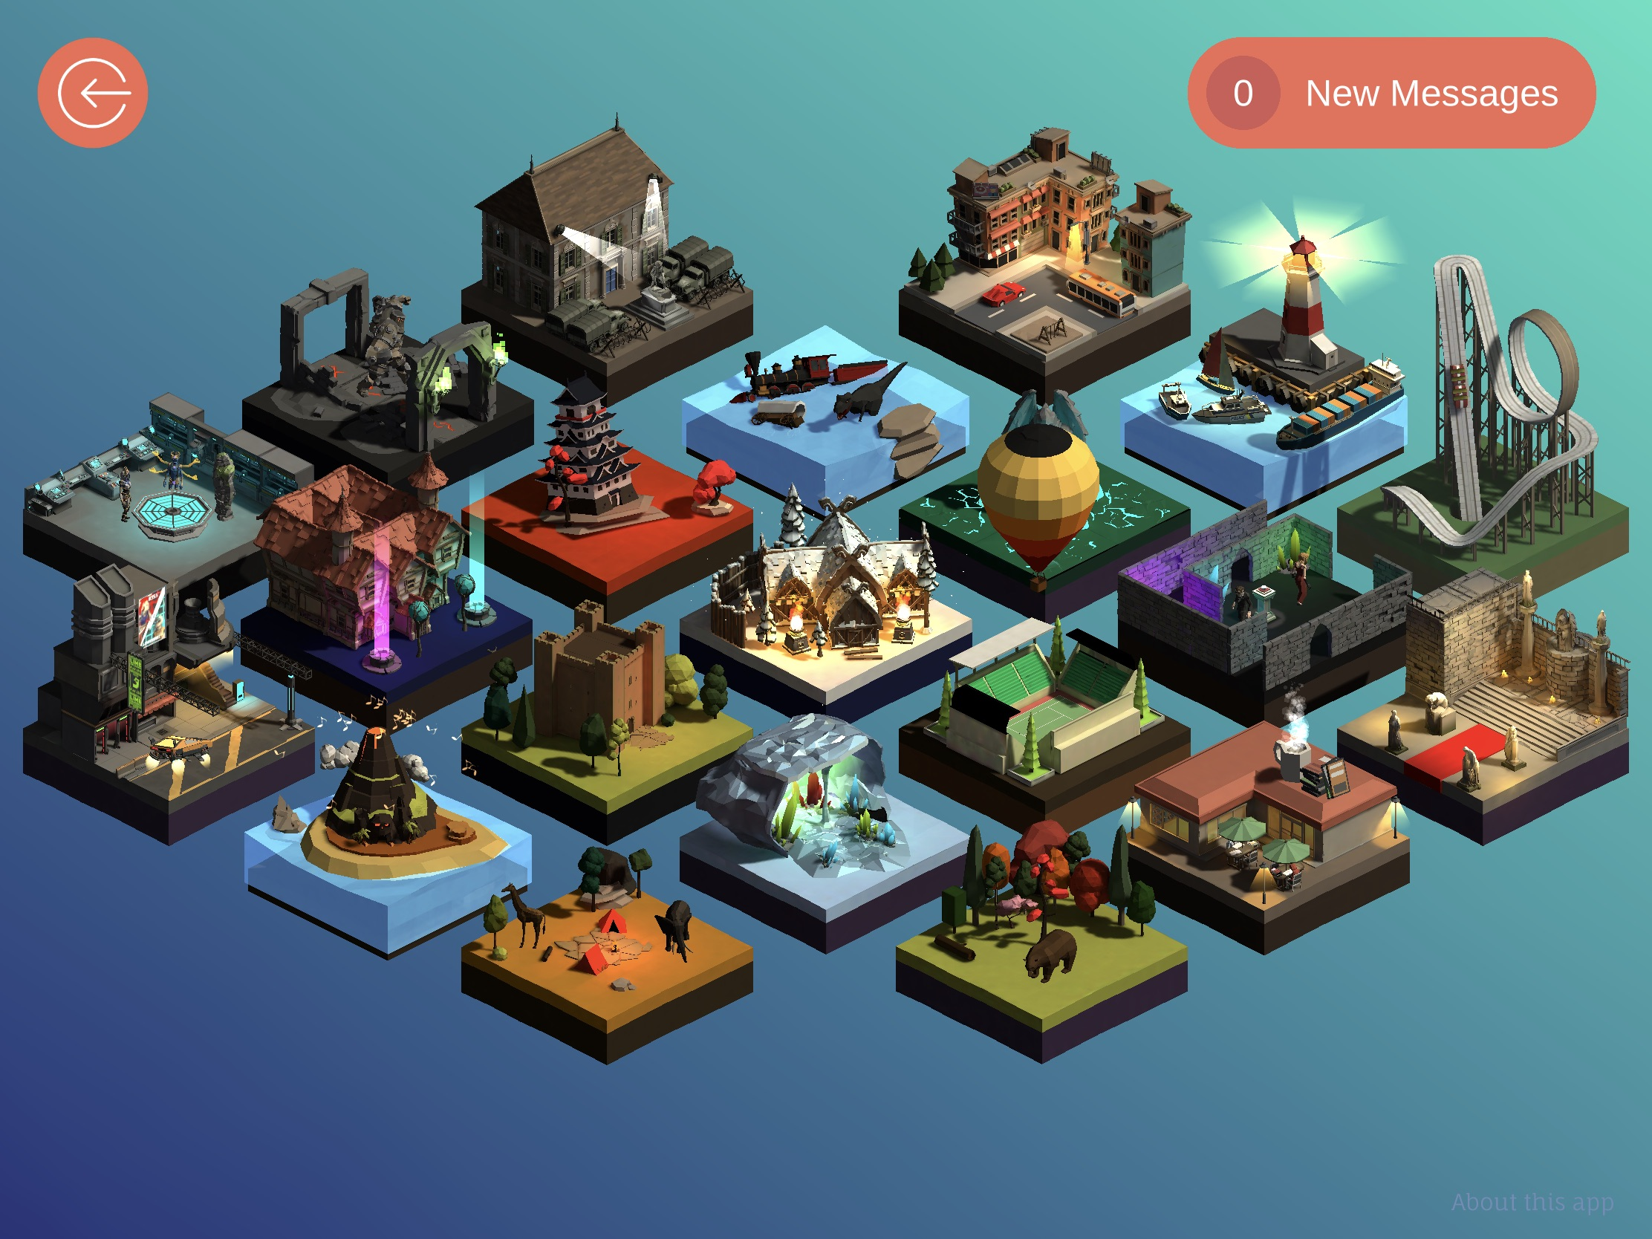
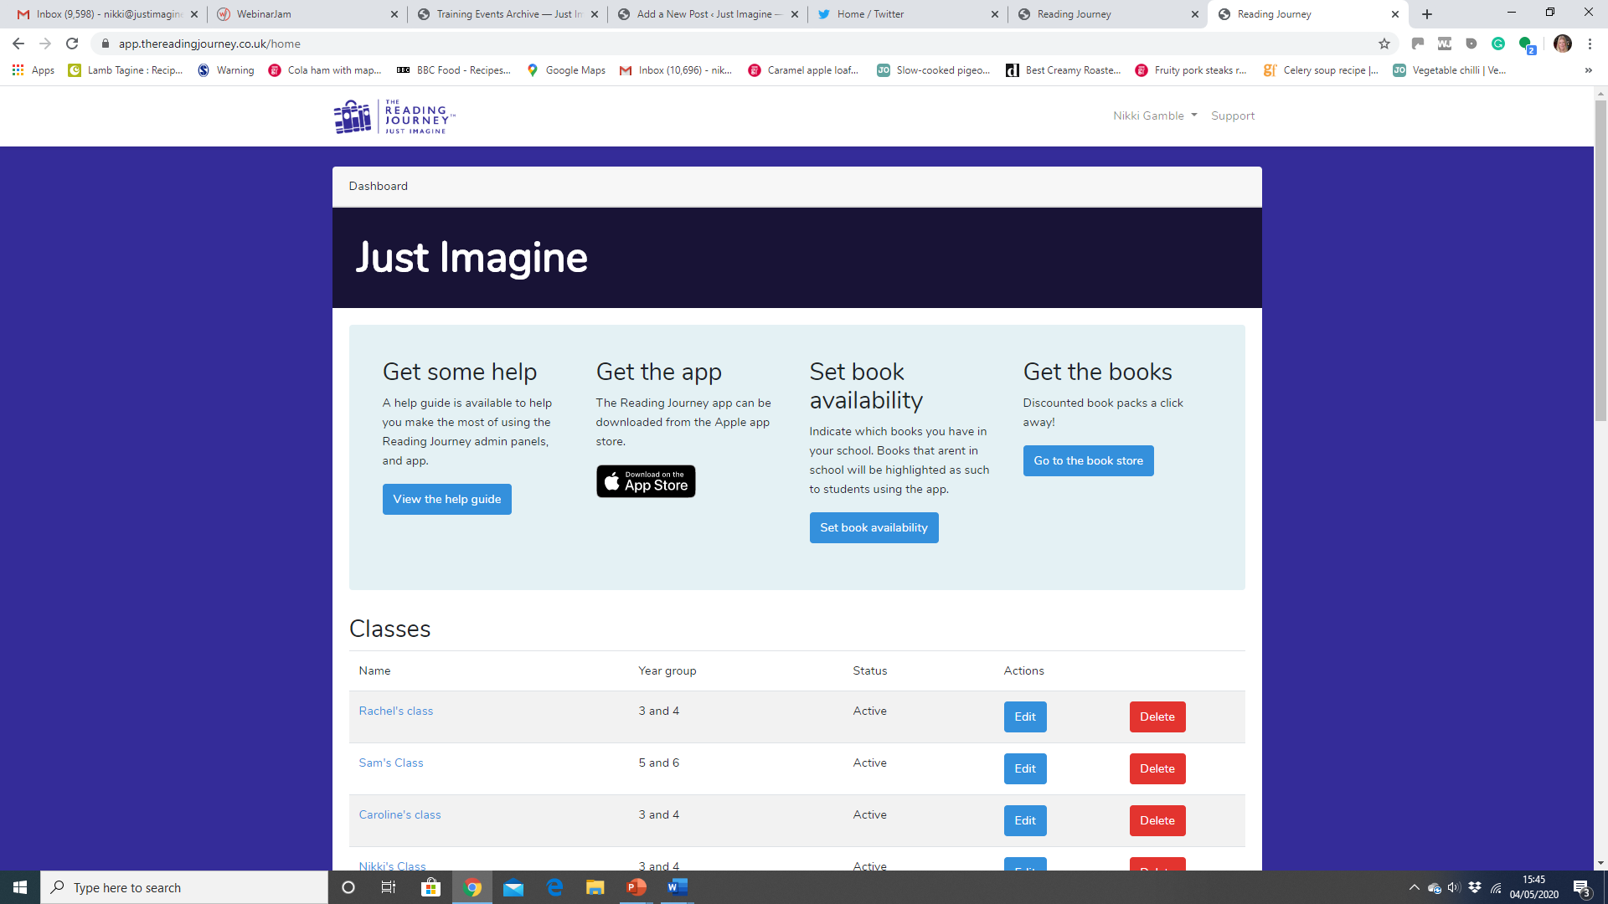

Slide 4
Messages from the teacher
Who is in the balloon this month?

Slide 5
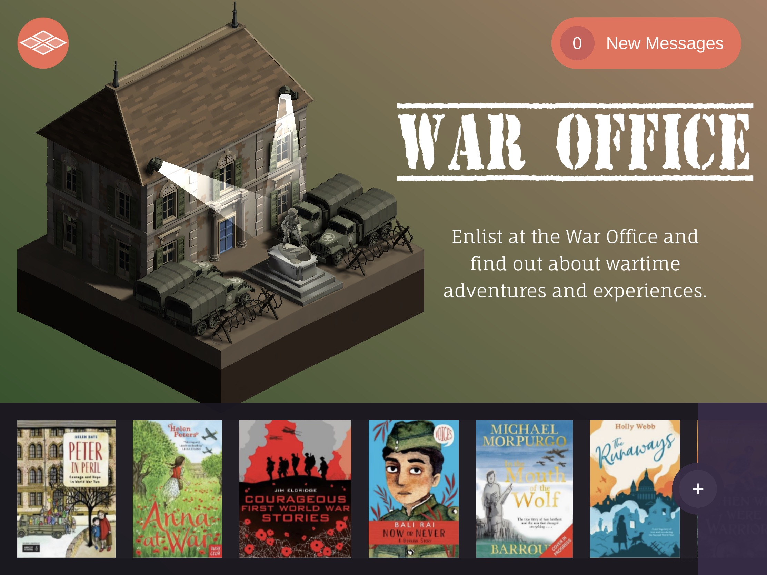
Browse the collection
Add your own book

Slide 6
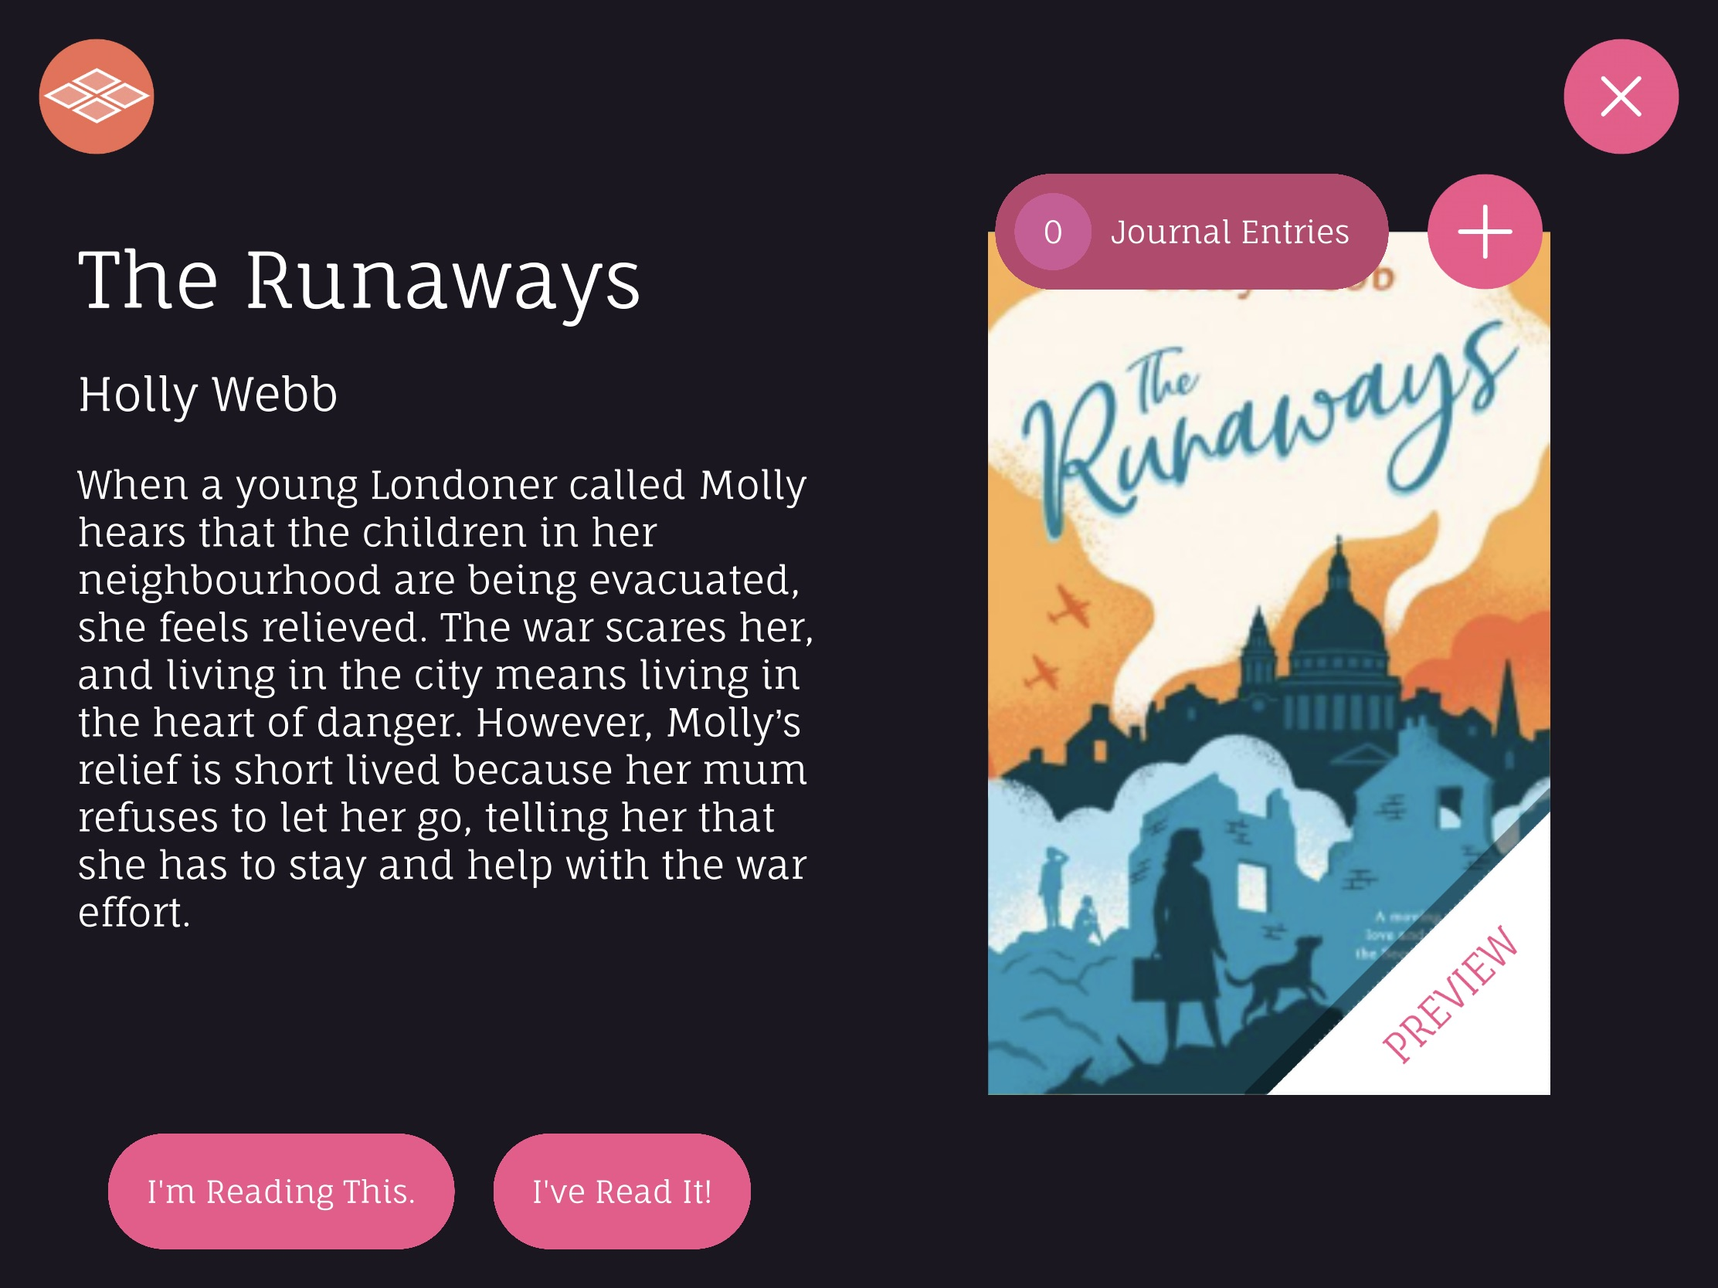
Write a journal entry
Read a sample chapter

Slide 7
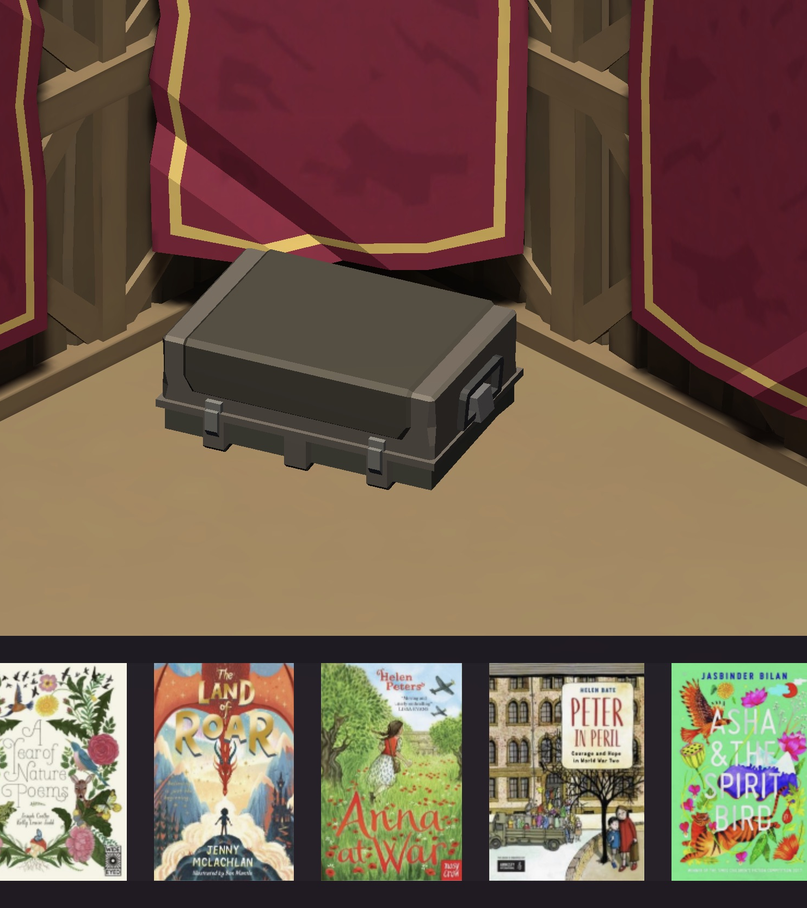
Home

Slide 8
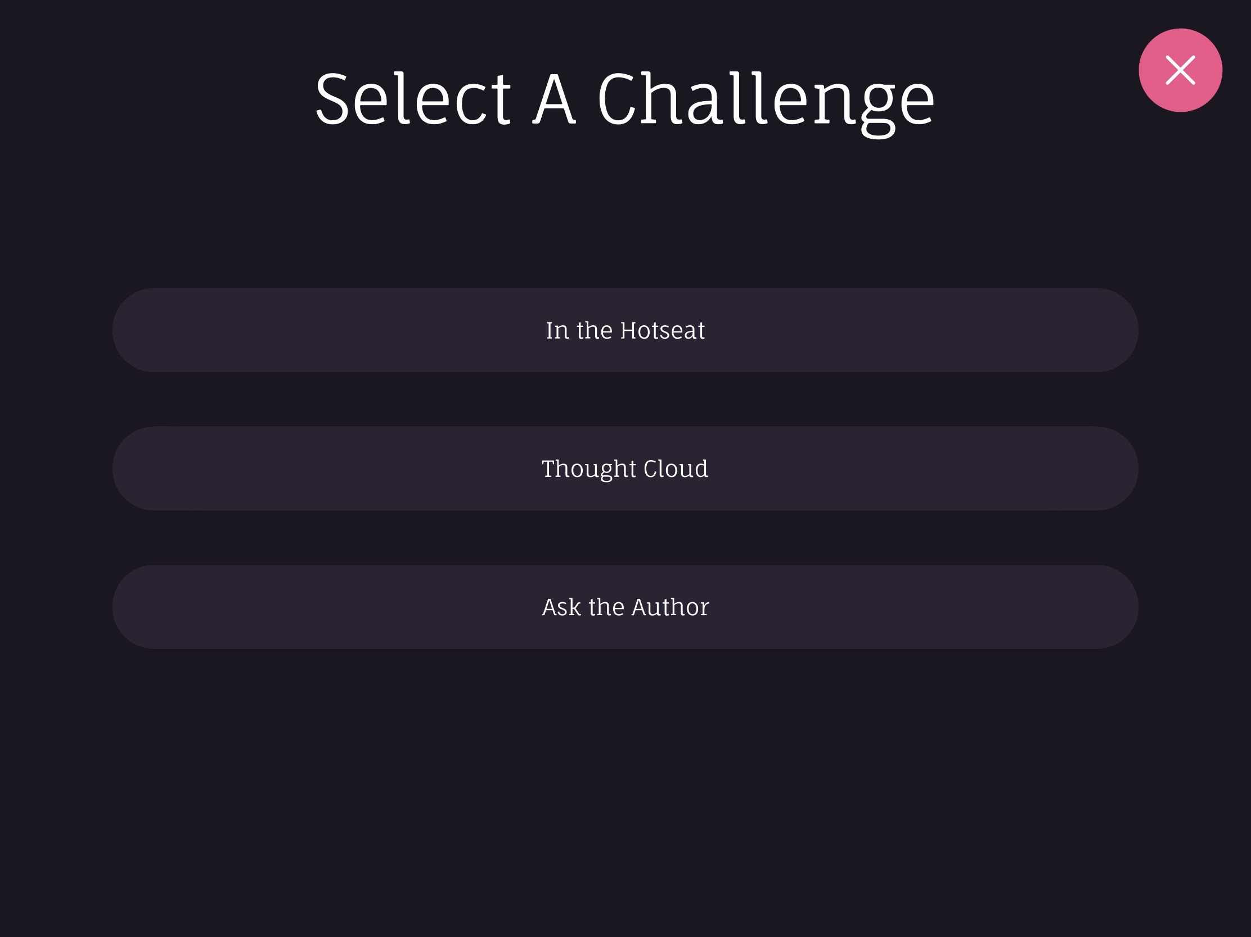
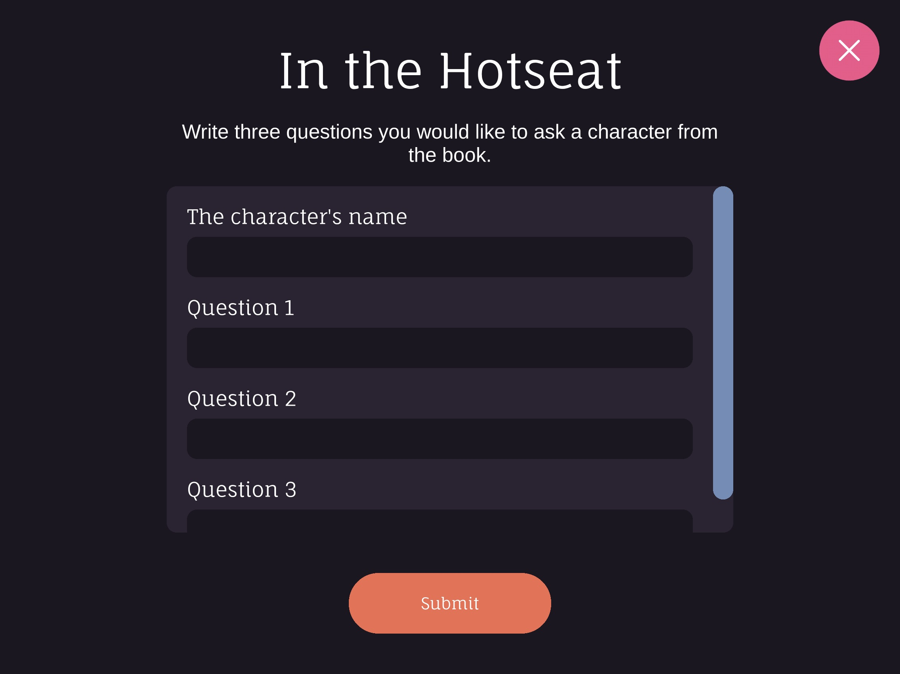
Finished the book? Complete a Challenge

